Slide 1
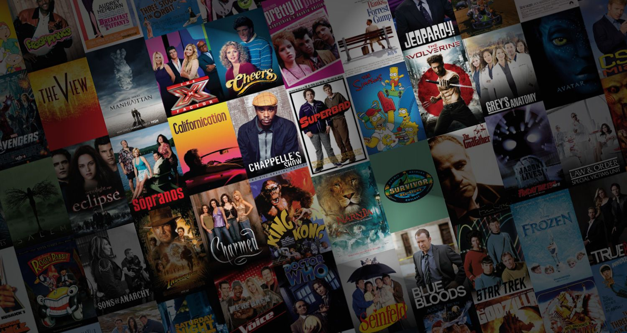
Introduction to Movie Recommendation Systems
A movie recommendation system is a type of filtering system designed to suggest movies to users based on their preferences, past viewing history, and behavior. These systems use various algorithms and data processing techniques to analyze large datasets of movies and user interactions to generate personalized recommendations.

Slide 2

Batch Members
Sahil Mane
Samiksha Surve
Balkrushna Padule Bhagyashree Neware
Guided By
Ritviz Singh Sir (Trainer)
Shiv Patel Sir (Trainer)
Google(Search Engine)
YouTube(Video Sharing Website) ChatGPT(Open AI Tool)

Slide 3

A basic introduction to how a movie recommendation system typically works: (with steps)
Step 1 : Data Collection:
The system gathers data on movies, including information such as Budget , genre, home page,id,keywords,original_language,original_title,overview,popularity … etc
This data is usually obtained from online databases like “ Kaggle ”.
User Interaction Data:
The system also collects data on user interactions, such as movies watched, ratings given, reviews written, and browsing history. This data helps build user profiles and understand their preferences.

Slide 4
How we use filtering :
Feature selection: The system analyzes the collected data to extract relevant features that can be used to describe both movies and users. These features could include genre preferences, actor preferences, director preferences, rating patterns, and more.
Algorithm Selection: Various recommendation algorithms are applied to match users with movies. These algorithms include:
Content-based Filtering: Recommends movies similar to those a user has liked in the past, based on features like genre, cast, or plot.
Collaborative Filtering: Recommends movies based on the preferences of users with similar tastes. This can be further divided into:
User-based Collaborative Filtering: Recommends movies liked by users who have similar preferences to the target user.
Item-based Collaborative Filtering: Recommends movies similar to those already liked by the target user.

Slide 5
Data Pre-processing steps :
Step 2: Data Preprocessing
1.Merging Datasets: You're merging two datasets, one containing information about movies and the other containing credits, using the "title" column as the common key.
2.Selecting Required Columns: After merging, you're selecting only the columns you need from the merged dataset.
3. Converting Strings to Lists: You're converting certain columns containing stringified lists into actual lists of names using a conversion function. This includes columns like "genres", "keywords", and "cast".
4. Limiting Cast Entries: You're limiting the number of cast entries to three using a function called Convert3.

Slide 6
5.Fetching Director from Crew: You're extracting the director's name from the "crew" column and adding it to the dataset.
6.Tokenizing Overview: You're tokenizing the "overview" column by splitting each string into a list of substrings based on whitespace.
7.Removing Spaces and Combining Columns: You're removing spaces between entities in certain columns like "genres", "keywords", "cast", and "crew", and then combining these columns into a single column called "tags" by concatenating them into a sentence format.

Slide 7

Step 2: Data Producing:
Producing data with Kafka involves sending messages, typically referred to as "records" or "events," to Kafka topics. Kafka is a distributed streaming platform that is commonly used for building real-time data pipelines and streaming applications. Here's a general overview of how you can produce data with Kafka.
Step 3 :Consume Data:
Set up Kafka consumers to read the data from the Kafka topics. These consumers will process the data and prepare it for storage in Amazon S3.
Step 4:Prepare Data for S3 for data warehousing:
In our consumer application, we formatted the data as desired for storage in Amazon S3. This may involve transforming the data into a suitable format such as JSON, Parquet, or CSV.

Slide 8
Step 5 : ETL (Extract , Transform and Load )
Once you've stored the data from your movie recommendation system into Amazon S3, you can set up an ETL (Extract, Transform, Load) pipeline using AWS Glue to process the data and make it queryable using Amazon Athena. Here's how you can achieve this:

Slide 9
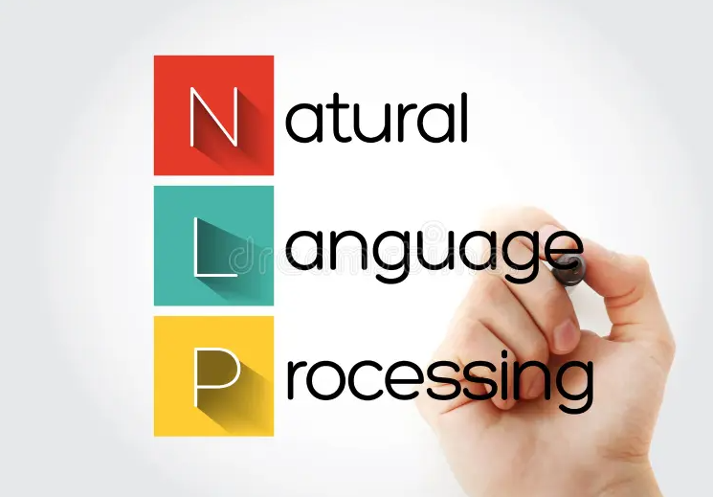
NLP(Natural Language Processing)
Natural language processing (NLP) is a subfield of Artificial Intelligence (AI).
Natural language processing (NLP) is a field of computer science and artificial intelligence that aims to make computers understand human language.
NLP is used in a wide range of applications, including machine translation, sentiment analysis, speech recognition, chatbots, and text classification.

Slide 10
Concept of Stemming and Lemmatization
NLTK (Natural Language Toolkit) is a Python library that provides tools and resources for natural language processing.
In this we can use 2 techniques :
In our Project we are going to do stemming on the basis of “title” column.
Stemming | Lemmatization
1.Simpler and Faster. | 1.More accurate but slower.
2.Operates on single word without knowledge of context. | 2.Can leverage context to find the correct lemma of word.
3.Eg having - hav (gives output without recognizing the word). | 3.Eg having – have (gives the output knowing the meaning of the word).

Slide 11
Vactorization and Bag of words algorithm
To convert the text data into numerical data in the form of 0’s and 1’s, we have smart ways which are known as vectorization.
“Bag of Words”
Algorithm take vectors of numbers as input, therefore we need to convert documents to fixed-length vectors of numbers.
The bag-of-words model is simple to understand and implement and has seen great success in problems such as language modeling and document classification.
Term Frequency(TF):
is a scoring of the frequency of the word in the current document.
Inverse Document Frequency(IDF):
is a scoring of how rare the word is across documents.

Slide 12
Advantages
The cosine similarity is beneficial because even if the two similar data objects are far apart by the Euclidean distance because of the size, they could still have a smaller angle between them.
Smaller the angle, higher the similarity.

Slide 13
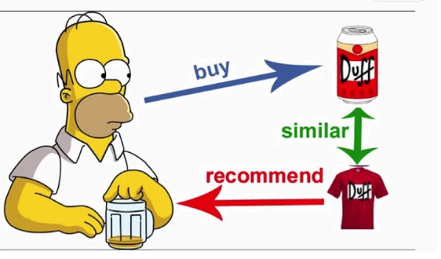
Using Cosine Similarity Cosine similarity is a metric, helpful in determining, how similar the data objects are irrespective of their size.

Slide 14
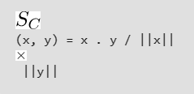
Cosine similarity is a metric, helpful in determining, how similar the data objects are irrespective of their size.
We can measure the similarity between two sentences in Python using Cosine Similarity. In cosine similarity, data objects in a dataset are treated as a vector. The formula to find the cosine similarity between two vectors is –
“|| ||” represents cosine similarities between two vectors.
x . y = product (dot) of the vectors ‘x’ and ‘y’.
||x|| and ||y|| = length (magnitude) of the two
vectors ‘x’ and ‘y’.
||x|| x ||y|| = regular product of two vectors “x”
And “y”.
Eg .take x = { 3, 2, 0, 5 } and y = { 1, 0, 0, 0 } and
calculate according to given formula.

Slide 15
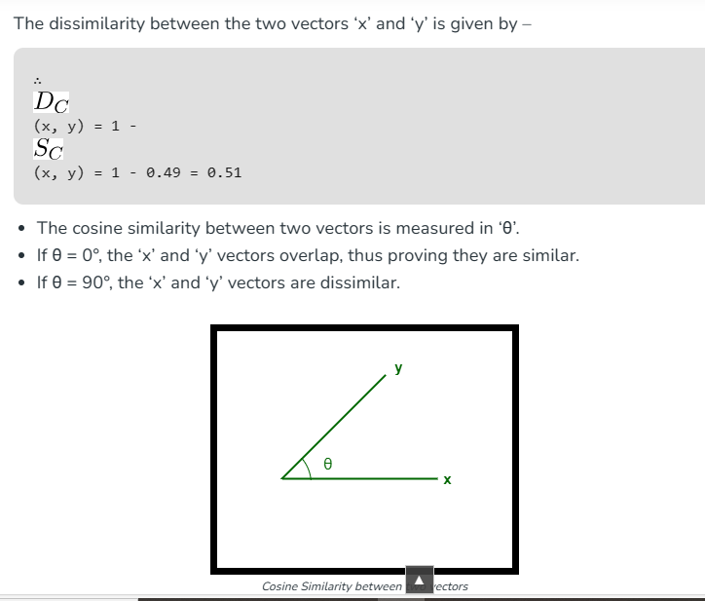
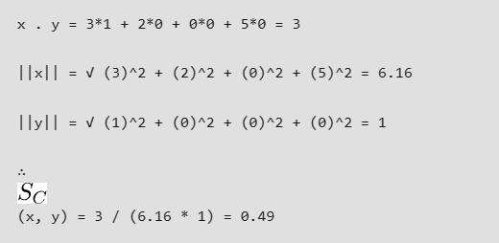
Calculations :

Slide 16
Creating a cosine_similarity model to check the Accuracy for movies recommendation
Importing a required library for data modelling:
from sklearn.metrics.pairwise import cosine_similarity
Do cosine_similarity according to vectors.
And sort it and enumerate it(according to serial-wise indexing).
After this our model will recommend movies according our title which we are given for searching .
eg .. recommend(“movie_name”)
Our model is recommending movies according to the “title”.

Slide 17
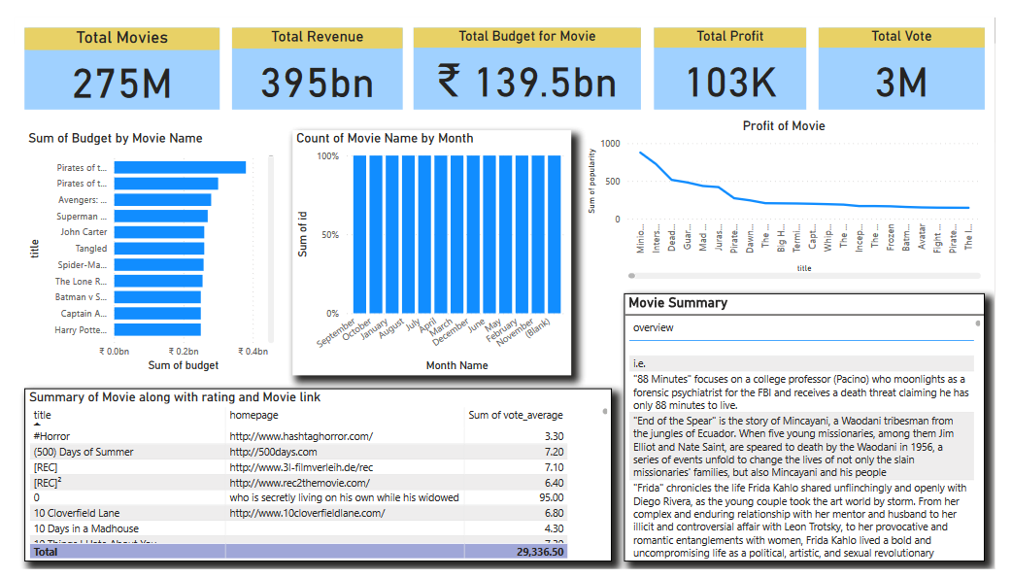
Visualization using PowerBI

Slide 18

A Big Thank You …!!!

